Slide 1
Creating Computed Columns
(view in slide show mode)
Intel Confidential
Notes:
1

Slide 2
This presentation describes how to create computed columns using SQLPathFinder and also provides examples of a few common functions used to build computed columns.

Slide 3
Agenda
Creating Computed Columns
Sample Functions
Analytical Functions

Slide 4
Create Computed Columns
To create a computed column, click the calculator icon on the toolbar.

Slide 5
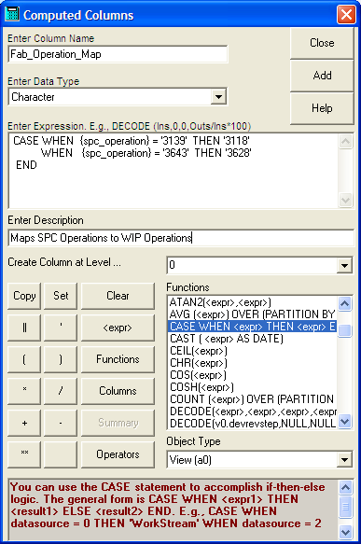
Create Computed Columns
This invokes the Computed Columns form.
An example of a completed form is shown at left

Slide 6
Create Computed Columns
The Enter Column Name text box is for the Column Header

Slide 7
Create Computed Columns
The Enter Data Type text box is for the computed column data type such as Character, Numeric, Float, and Date. Use Float to specify numeric columns which will include a decimal place. E.g., 10.5. Use Numeric to specify integers. E.g., 10

Slide 8
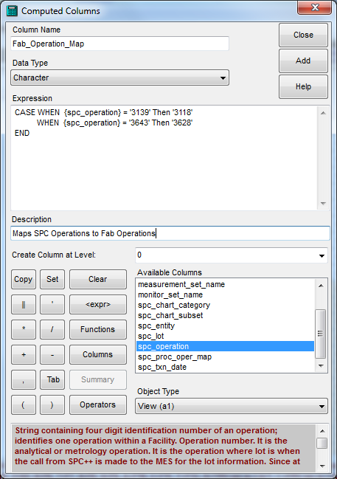
Create Computed Columns
The Enter Expression box is where you specify the computed expression. The expression is made up of columns, operators, keywords and functions. Make sure you double-click columns from the Columns list box (which shows up when you click the Columns button) to add them. Don’t type them in

Slide 9
Create Computed Columns
Specify an optional description for the column in the Enter Description text box.

Slide 10
Create Computed Columns
Select the level at which the column should be created. If you want to build on the results of past expressions, you must create the new expression at a higher level. At any given level, SQLPathFinder will show you which columns you can use. Always try to create a column at the lowest possible level. If you can see the column, then you can use it.

Slide 11
Create Computed Columns
The Functions, Columns, and Operators buttons on the calculator pad bring up available functions, columns, and operators respectively. Note that functions will vary depending on the SQL engine being used. E.g., LEAD and LAG functions exist in Oracle but not SQL Server.

Slide 12
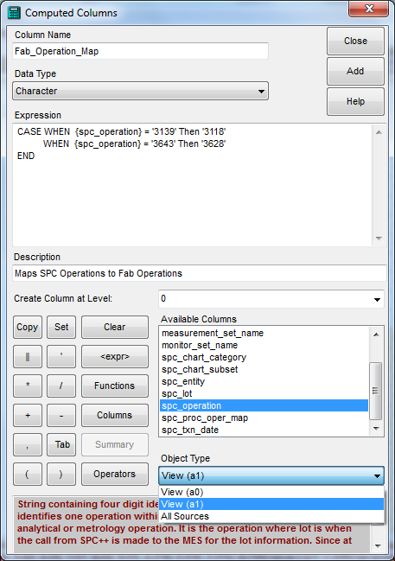
Create Computed Columns
Under Object Type, select the source that displays the columns you wish to use. If you want to use columns from more than one source, select All Sources

Slide 13
Create Computed Columns
Click the Add button to add the expression to the query.

Slide 14
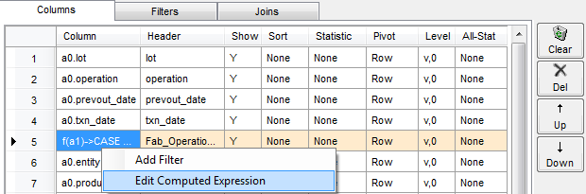
Create Computed Columns
Right-click over the computed column on the Query Grid and choose option Edit Computed Expression on the drop-down menu to edit the computed column

Slide 15
Sample Issues with SQLite
SQLite is used during the All Sources or Join level of a query or on its own against Text files
If all your expression variables are Integer, SQLite will do Integer arithmetic.
  E.g., 5/2 becomes 2 instead of 2.5
To resolve:
  Multiply expression by 1.0. E.g.,:
    1.0 * 5/2
  Convert Integers to REAL using CAST. E.g.,:
    CAST (5 AS REAL) / CAST (2 AS REAL)

Slide 16
Agenda
Creating Computed Columns
Sample Functions
Analytical Functions

Slide 17
Sample Functions
Function
Result
'A' || 'BC'
'ABC'
The concatenation operator (|| in Oracle, SQLite, Teradata or + in SQL Server …) allows you to concatenate two strings.
What will the above yield? Click next to see.

Slide 18
Sample Functions
Function
Result
SUBSTR('String',1,3)
'Str'
The SUBSTR function lets you extract a portion of a string. It takes 3 arguments:
The string to parse
The starting position of the extraction with 1 referring to the first character in the string
An optional number of characters to extract. Exclude to extract to end of the string
What will the above yield? Click next to see.

Slide 19
Sample Functions
Function
Result
SUBSTR('String',-3,2)
'in'
-3-2-1
The SUBSTR function also lets you extract data from the right side of the string. Use a negative starting position to pull data from the right side:
-1 refers to the rightmost character,
-2 to the second character on the right and so on.
What will the above yield? Click next to see.

Slide 20
Sample Functions
Function
Result
LENGTH ('string‘)
6
The LENGTH function returns the length of a string.
What will the above yield? Click next to see.

Slide 21
Sample Functions
Function
Result
Spf_Fn$Instr ('String' , 'r' , 1 , 1)
3
The spf_FN$Instr function searches for a string pattern in a character column. It takes 4 arguments:
The string to parse
The pattern to search for
The optional starting position of the search, with 1 being the 1st character in the string and the default
The optional occurrence of the pattern, with the default being 1 for the first occurrence
What will the above yield? Click next to see.

Slide 22
Sample Functions
Function
Result
Spf_Fn$Instr('MISSISSIPPI', 'I' , 4 , 2)
8
What will the above yield? Click next to see.
The above expression finds the second
occurrence of the I starting in position 4
of the string.

Slide 23
Sample Functions
Function
Result
REPLACE ('Slot:21', 'Slot:', '')
'21'
The REPLACE function replaces a particular pattern in a string with another pattern. It takes 3 arguments:
The string to replace
The pattern to search for and replace
The replacement string
What will the above yield? Click next to see.

Slide 24
Sample Functions
Function
Result
SUBSTR ('Slot:21' , spf_Fn$Instr ('Slot:21' , ':' ) + 1,1,1)
'21'
Functions can also be nested. In this case, expressions are evaluated inwards to outwards.
What will the above yield? Click next to see.
The INSTR function looks for the occurrence of
the : in the string, “Slot:21”. The SUBSTR function
has no 3rd argument so it extracts from one
position beyond the : to the end of the string

Slide 25
Sample Functions - Subtract Dates
  A common computation is to subtract dates. Function SPF_FN$Date_Diff subtracts two dates (across any database type) and returns the delta time in fractional days
    Set the computed column data type to FLOAT
    Later date is argument 1
    E.G.,
      SPF_FN$Date_Diff ({Test_End_date} , {Test_Start_Date})
      SPF_FN$Date_Diff ( {Test_End_date} , {Test_Start_Date}) * 24.0
Returns results in Fractional Hours
Notes:
Arithmetic with Dates
Since the database stores dates as numbers, you can perform calculations using arithmetic operators such as addition and subtraction. You can add and subtract number constants as well as dates.
You can perform the following operations:

Slide 26
Sample Functions - CASE
The CASE expressions facilitates if-then-else logic allowing you to assign the value of a column differently depending on different conditions
The format of the CASE expression is as follows:
}
CASE
WHEN <condition> THEN <expression>
[WHEN <condition> THEN <expression>]
.
.
.
[WHEN <condition> THEN <expression>...]
[ELSE <expression>]
END
Up to
128
WHEN
Clauses
Notes:
The CASE statement provides for IF-THEN-ELSE logic.
The CASE statement uses keywords "when", "then", "else", and "end" to indicate the logic path The expression begins with the keyword "CASE" and ends with "END", and supports up to 128 "WHEN" clauses and an optional "ELSE" clause.

Slide 27
Sample Functions - CASE
  In the below expression, the value of computation
  spc_operation is conditional. If column {wip_operation} equals 3118 or 3119, then a value of 3139 is returned. If 3628, then 3643 is returned. Otherwise Null is returned.
SPC_OPERATION
CASE WHEN {wip_operation} = '3118' OR
{wip_operation} = '3119' THEN '3139'
WHEN {wip_operation} = '3628' THEN '3643'
ELSE Null
END
SPC_OPERATION WIP_OPERATION
------------- -----------------
3139 3118
3139 3119
3643 3628
1210

Slide 28
Agenda
Creating Computed Columns
Sample Functions
Analytical Functions

Slide 29
Analytical Functions
Among the functions on the Computed Column form, are powerful analytical functions of the form:
Function () OVER (PARTITION BY … ORDER BY …)
Examples:
  DENSE_RANK which ranks data. E.g., get the last 50 data points or the lowest 2 wafer numbers…
  LEAD which returns future row values on the current row
  LAG which returns past row values on the current row
  AVG, SUM, STDDEV, Percentile … which return summarized data with raw data. E.g., for z-scores (x_{i} – AVG(x)) / STDDEV(x)

Slide 30
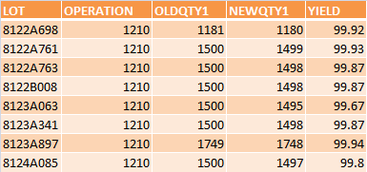
Analytical Functions – Ranking Data
Say you want to return how lots rank by yield
The Dense_Rank function numbers data 1 .. n based on data ordering within a rank group
  E.g., in the table below, say you want to rank lots at an operation by yield in ascending order
The Partition clause of this function first groups the data by operation
Dense_Rank () OVER (PARTITION BY {operation} ORDER BY {yield} ASC)

Slide 31
Analytical Functions – Ranking Data
Say you want to return how lots rank by yield
The Dense_Rank function numbers data 1 .. n based on data ordering within a rank group
  E.g., in the table below, say you want to rank lots at an operation by yield in ascending order
The Order By clause sorts data by yield in ascending order within each partition(i.e., operation)
Dense_Rank () OVER (PARTITION BY {operation} ORDER BY {yield} ASC)

Slide 32

Analytical Functions – Ranking Data
Say you want to return how lots rank by yield
The Dense_Rank function numbers data 1 .. n based on data ordering within a rank group
  E.g., in the table below, say you want to rank lots at an operation by yield in ascending order
The result…
Dense_Rank () OVER (PARTITION BY {operation} ORDER BY {yield} ASC)

Slide 33
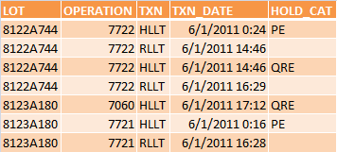
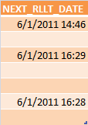
Analytical Functions – LEAD (Oracle only)
LEAD lets you return future row values for a column on the current row
CASE WHEN {txn} = ‘HLLT’ THEN
LEAD ({txn_date}, 1, NULL) OVER (PARTITION BY {lot} ,
{operation} ORDER BY {txn_date} ASC)
ELSE NULL END
Column value to get
Get value on next 1 row for partition & ordering
Return NULL if no next value

Slide 34
That concludes the presentation
on Creating Computed Columns
Intel Confidential

